Slide 1
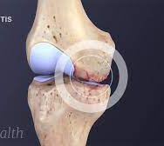
Leveraging CNNs for Knee Osteoarthritis Severity Classification

Slide 2
DATASET
www.kaggle.com/datasets/shashwatwork/knee-osteoarthritis-dataset-with-severity
Features:
Healthy 2286
Doubtful 1046
Minimal 1516
Moderate 757
Severe 173

Slide 3

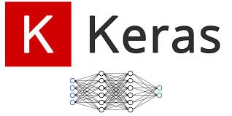

MODULES
Keras Matplotlib Numpy Pandas Seaborn Sklearn Tensorflow

Slide 4
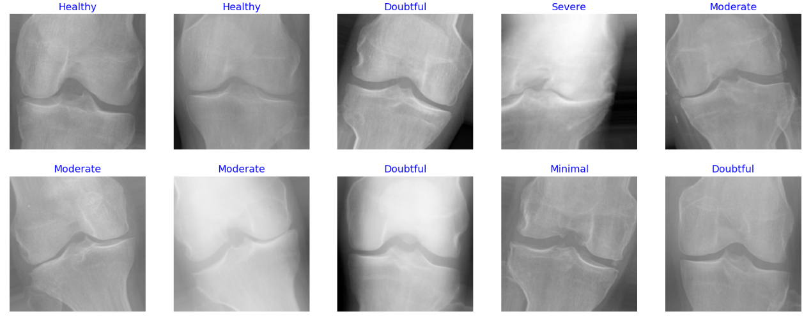
DATA Preparation
Applying TRIM function to the Training dataset
Data Augmentation.

Slide 5
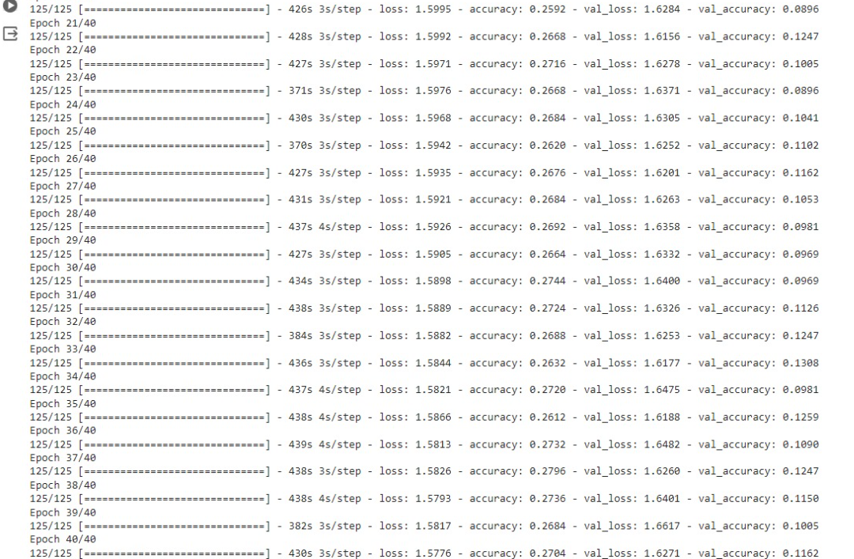
MODEL BUILDING
Efficient NETB5

Slide 6
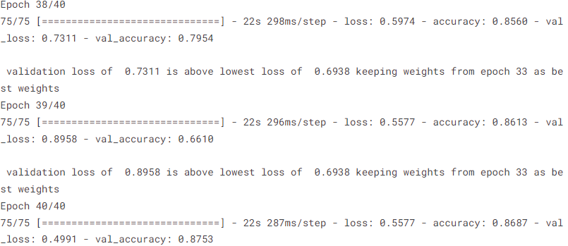
Inception V3

Slide 7
Results

Slide 8
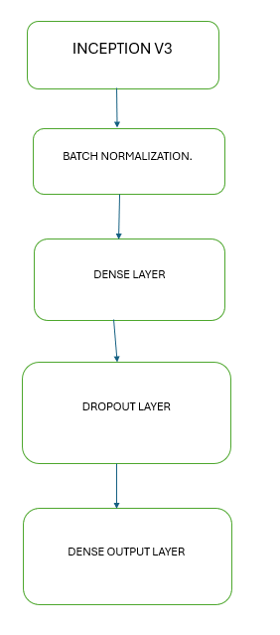
Model Architecture

Slide 9
Challenges

